Slide 1

Operation Analytics and Investigating Metric Spike
Shilpi Soni

Slide 2


Project Description
Operational Analytics is a crucial process that involves analyzing a company's end-to-end operations.
Operation analytics is the subset of data analytics that mainly focuses on the improving efficiency of the operations in the company.
It shows how currently different operations are working and how those operations can be improved for better profits.
In this project, I have answered such questions which are generally asked by the different departments in a company like the operations team, support team, marketing team, etc.

Slide 3
approach towards the project
DEFINE CASE STUDY AND GOALS:
Use SQL skills to extract meaningful insights from the data set.
Job Data Analysis
Investigating Metric Spike
DATA COLLECTION:
Use My SQL to extract the required data from the given database.
DATA ANALYSIS:
Using extract, aggregation function ,subqueries, where, Group by, order by Distinct and other functions required.
INSIGHTS & RECOMMENDATIONS:
Using: Excel (for graphs, charts &tables), images and icons
Actionable Implementation:
PowerPoint : for final presentation

Slide 4



TECH-STACK USED
Why choose MySQL ??
Workbench 8.0
There are some major advantages of using traditional relational databases, which we interact with using SQL.
The five most apparent are:
SQL is easy to understand..
Traditional databases allow us to access data directly..
Traditional databases allow us to audit and replicate our data.
SQL is a great tool for analyzing multiple tables at once.
SQL allows you to analyze more complex questions than dashboard tools like Google Analytics.

Slide 5


Case Study 1: Job Data Analysis
Tasks:
Jobs Reviewed Over Time
Throughput Analysis
Language Share Analysis
Duplicate Rows Detection

Slide 6

Task A: Jobs Reviewed Over Time
Objective: Calculate the number of jobs reviewed per hour for each day in November 2020.
dates | jobs_reviewed_per_hour
11/30/2020 | 180
11/29/2020 | 180
11/28/2020 | 218
11/27/2020 | 35
11/26/2020 | 64
11/25/2020 | 80

Slide 7
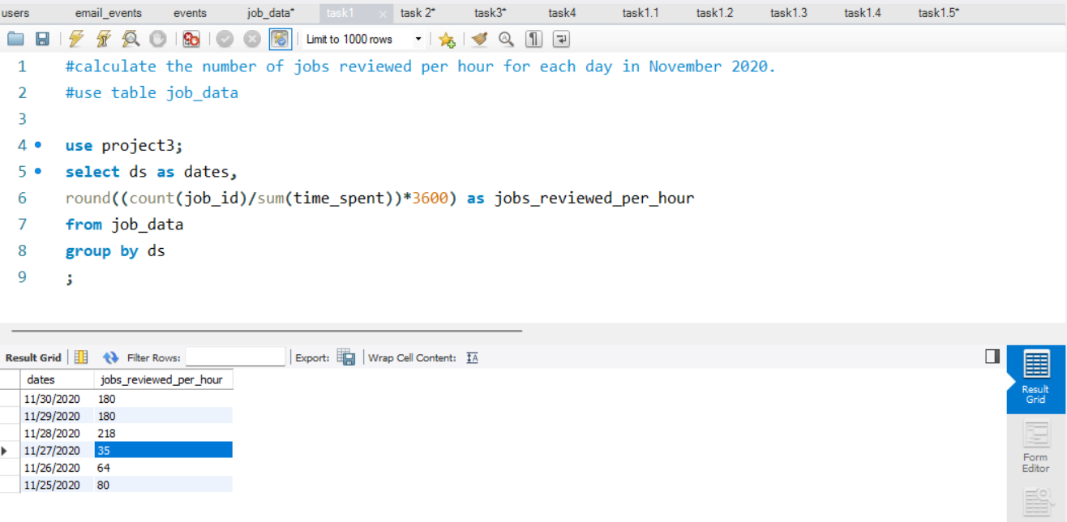
Task A: Write an SQL query to calculate the number of jobs reviewed per hour for each day in November 2020.

Slide 8
Task b: Throughput Analysis
Objective: Calculate the 7-day rolling average of throughput (number of events per second).

Slide 9
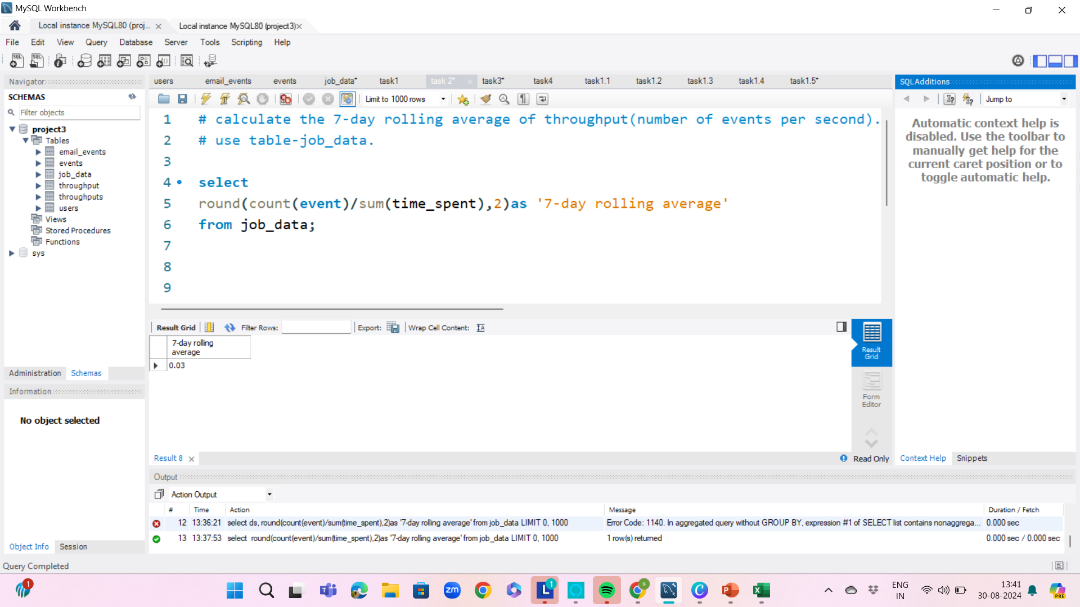
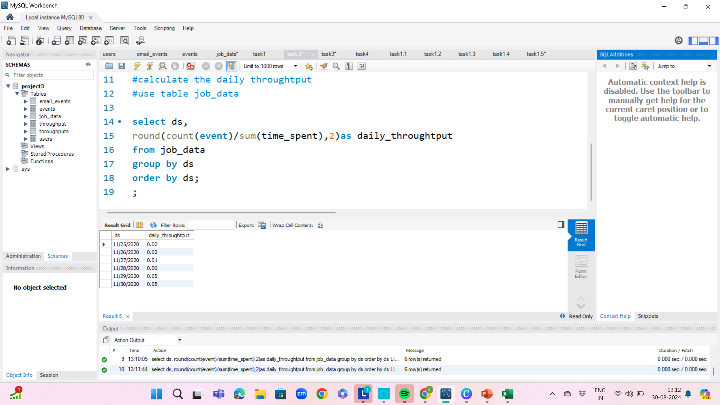
Task b: Write an SQL query to calculate the 7-day rolling average of throughput. Additionally, explain whether you prefer using the daily metric or the 7-day rolling average for throughput, and why?

Slide 10


Task c: Language Share Analysis
Objective: Calculate the percentage share of each language in the last 30 days.
languages | percentage_share
French | 34.90
Persian | 32.89
Italian | 15.10
Arabic | 8.39
English | 5.03
Hindi | 3.69

Slide 11
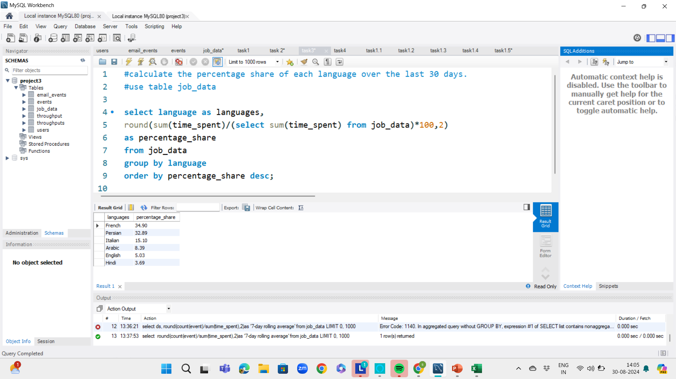
Task b: Write an SQL query to calculate the percentage share of each language over the last 30 days.

Slide 12


Task d: Duplicate Rows Detection
Objective: Identify duplicate rows in the data
actor_id | duplicate
1003 | 2

Slide 13
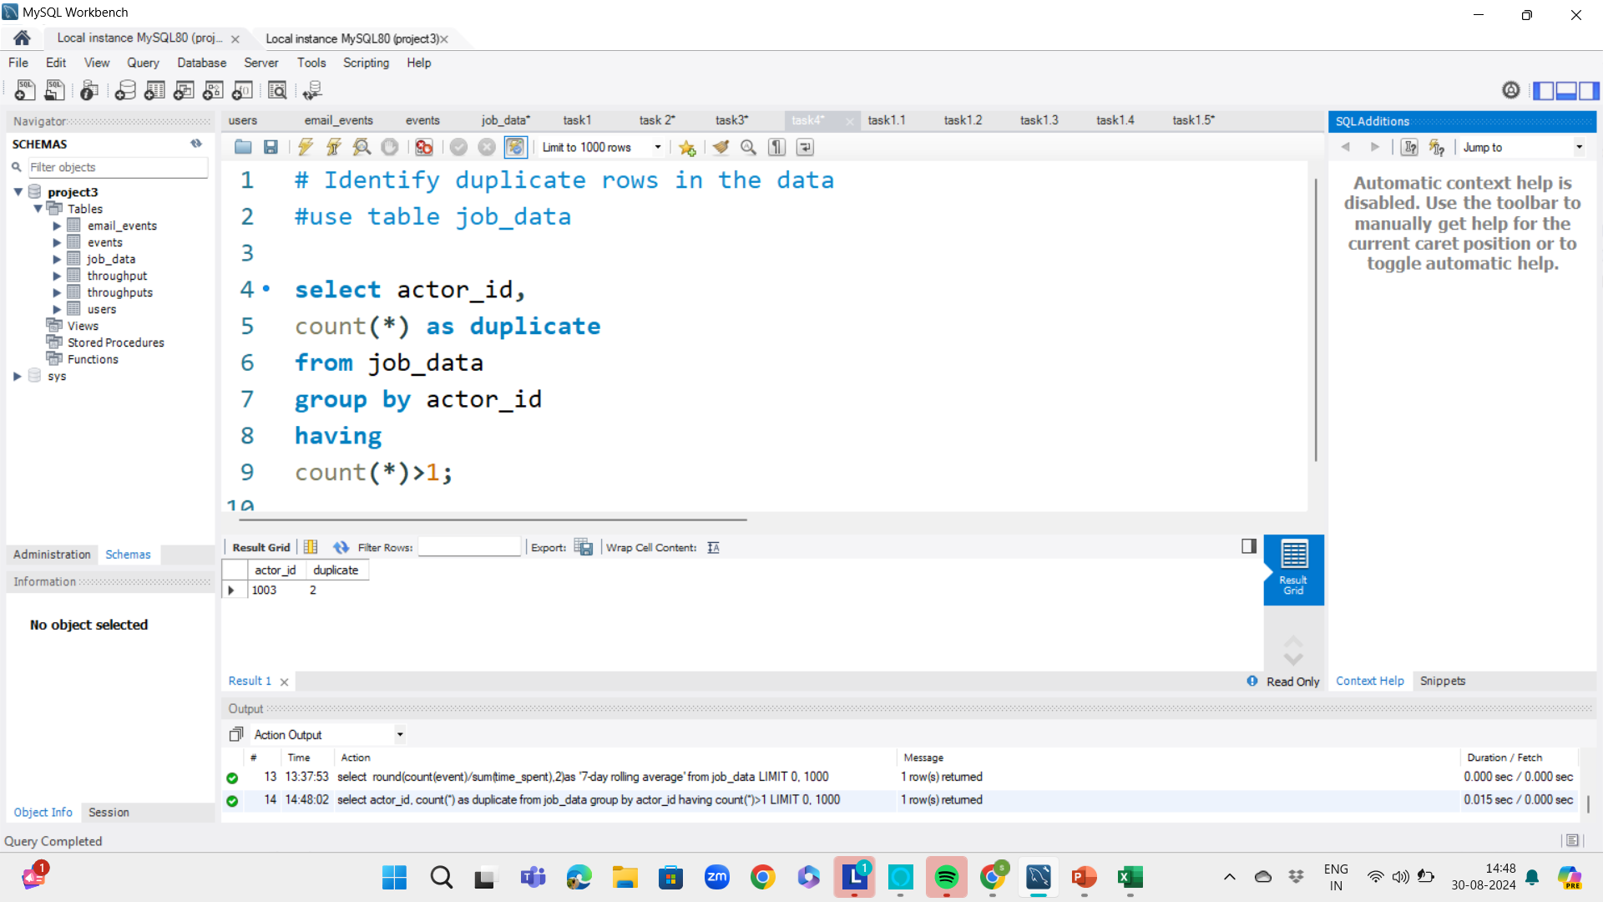
Task d: Write an SQL query to display duplicate rows from the job_data table.

Slide 14


Case Study 2: Investigating Metric Spike
Tasks:
Weekly User Engagement
User Growth Analysis
Weekly Retention Analysis
Weekly Engagement Per Device
Email Engagement Analysis

Slide 15

Task a: Weekly User Engagement
Objective: Measure the activeness of users on a weekly basis.

Slide 16
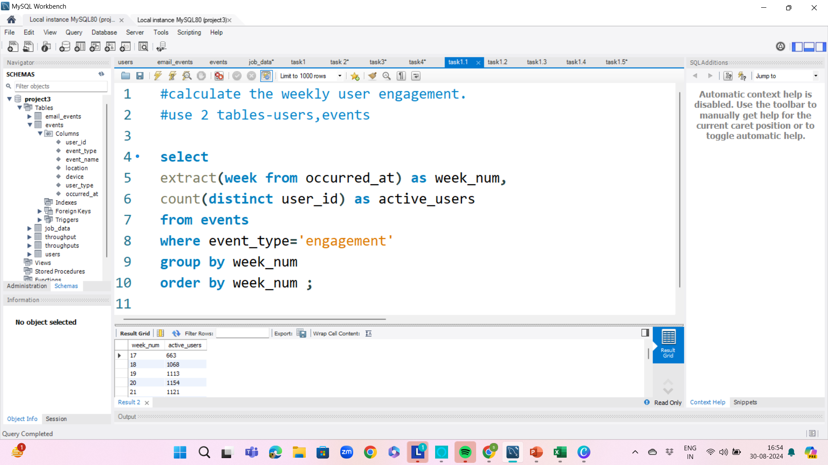
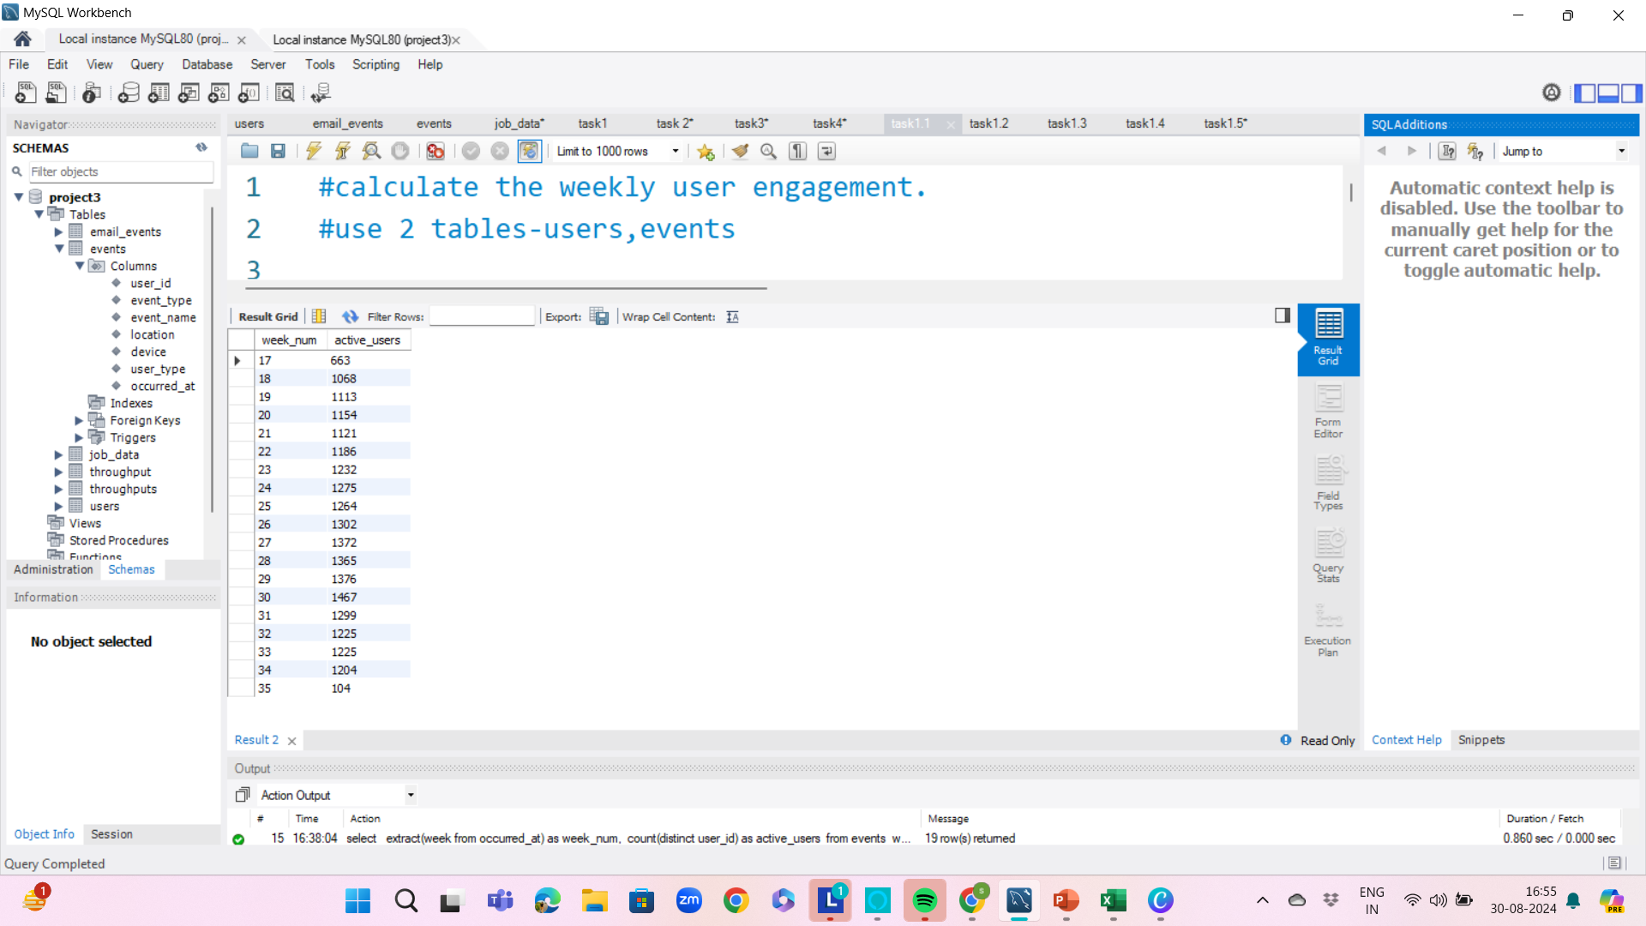
Task a: Write an SQL query to calculate the weekly user engagement.

Slide 17
Task b: User Growth Analysis

Slide 18
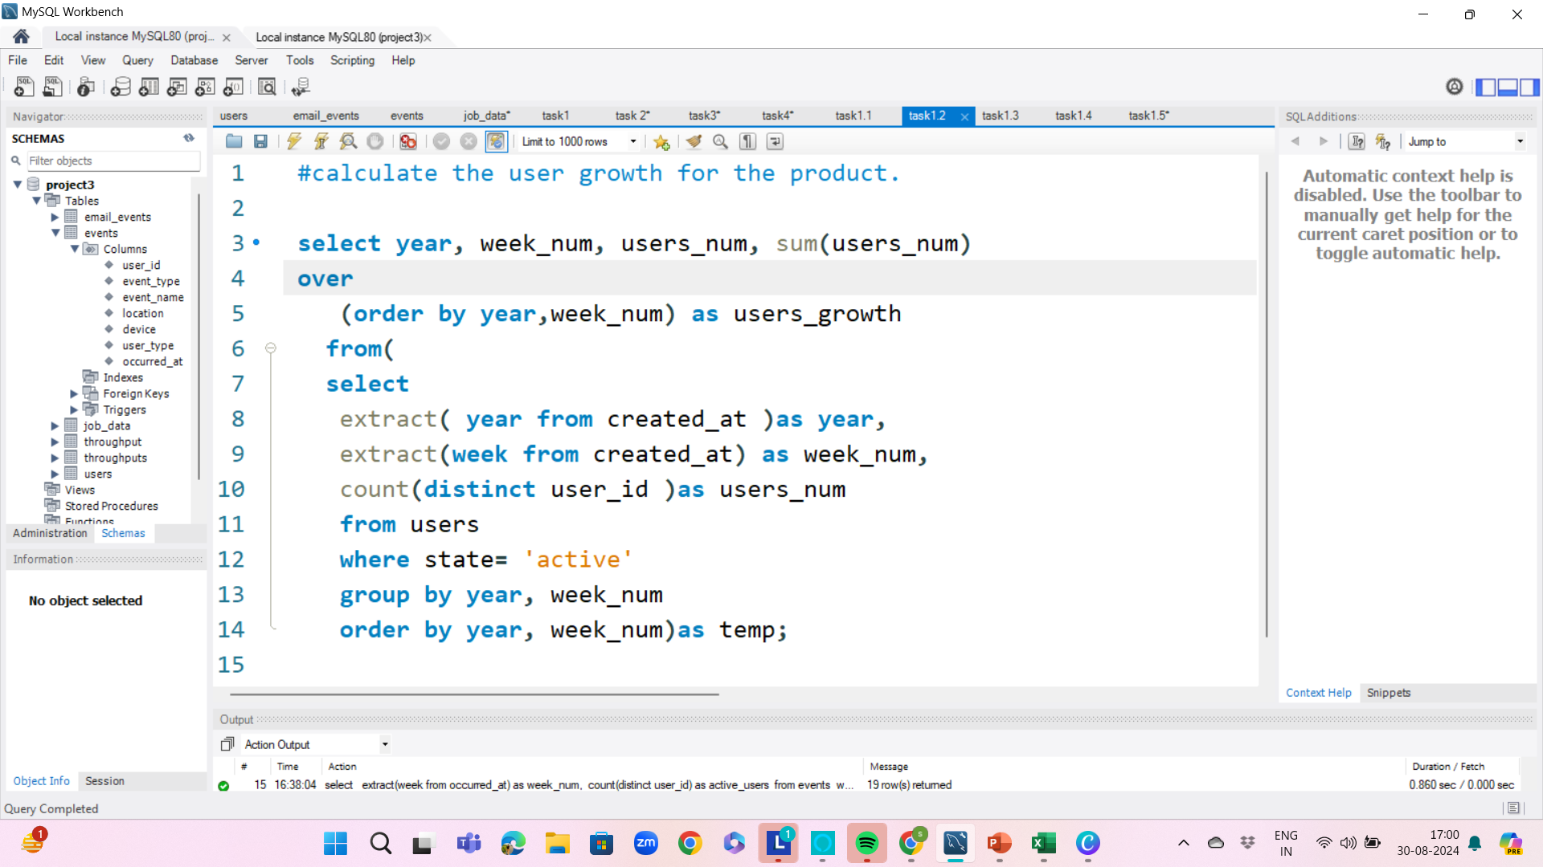
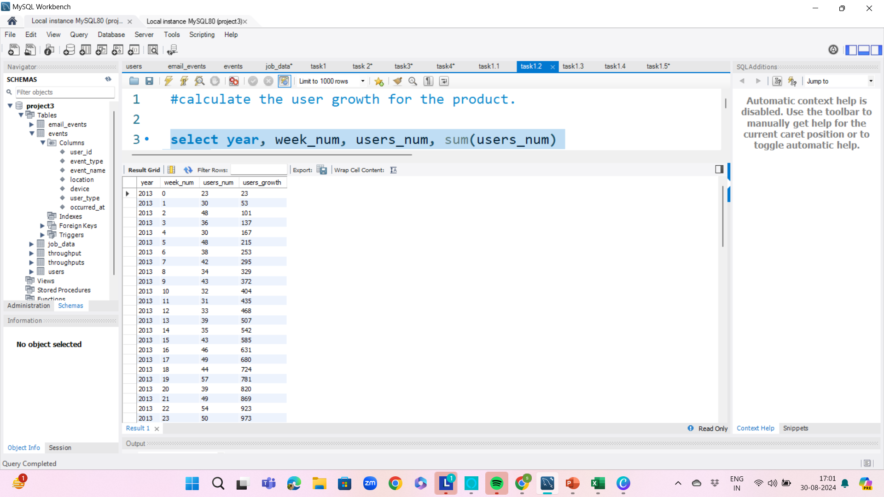
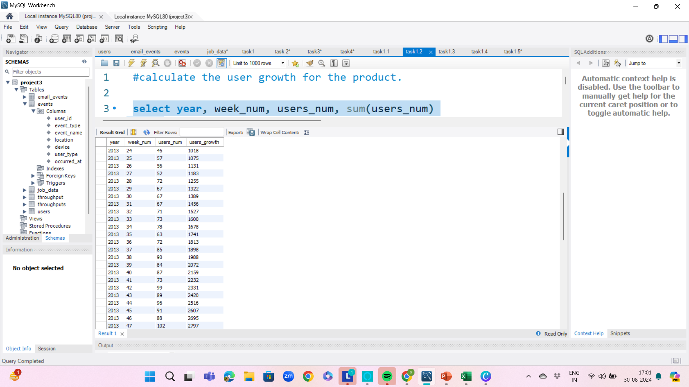
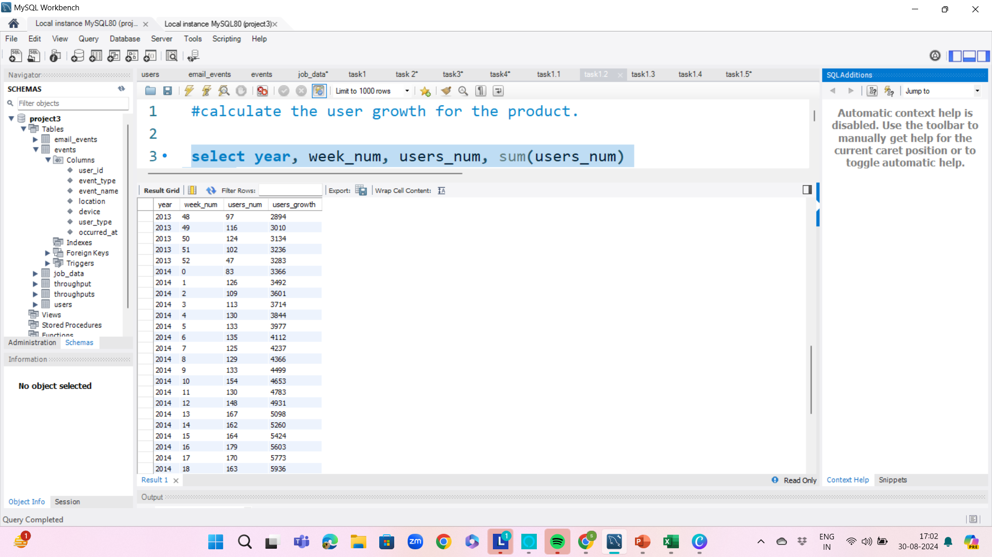
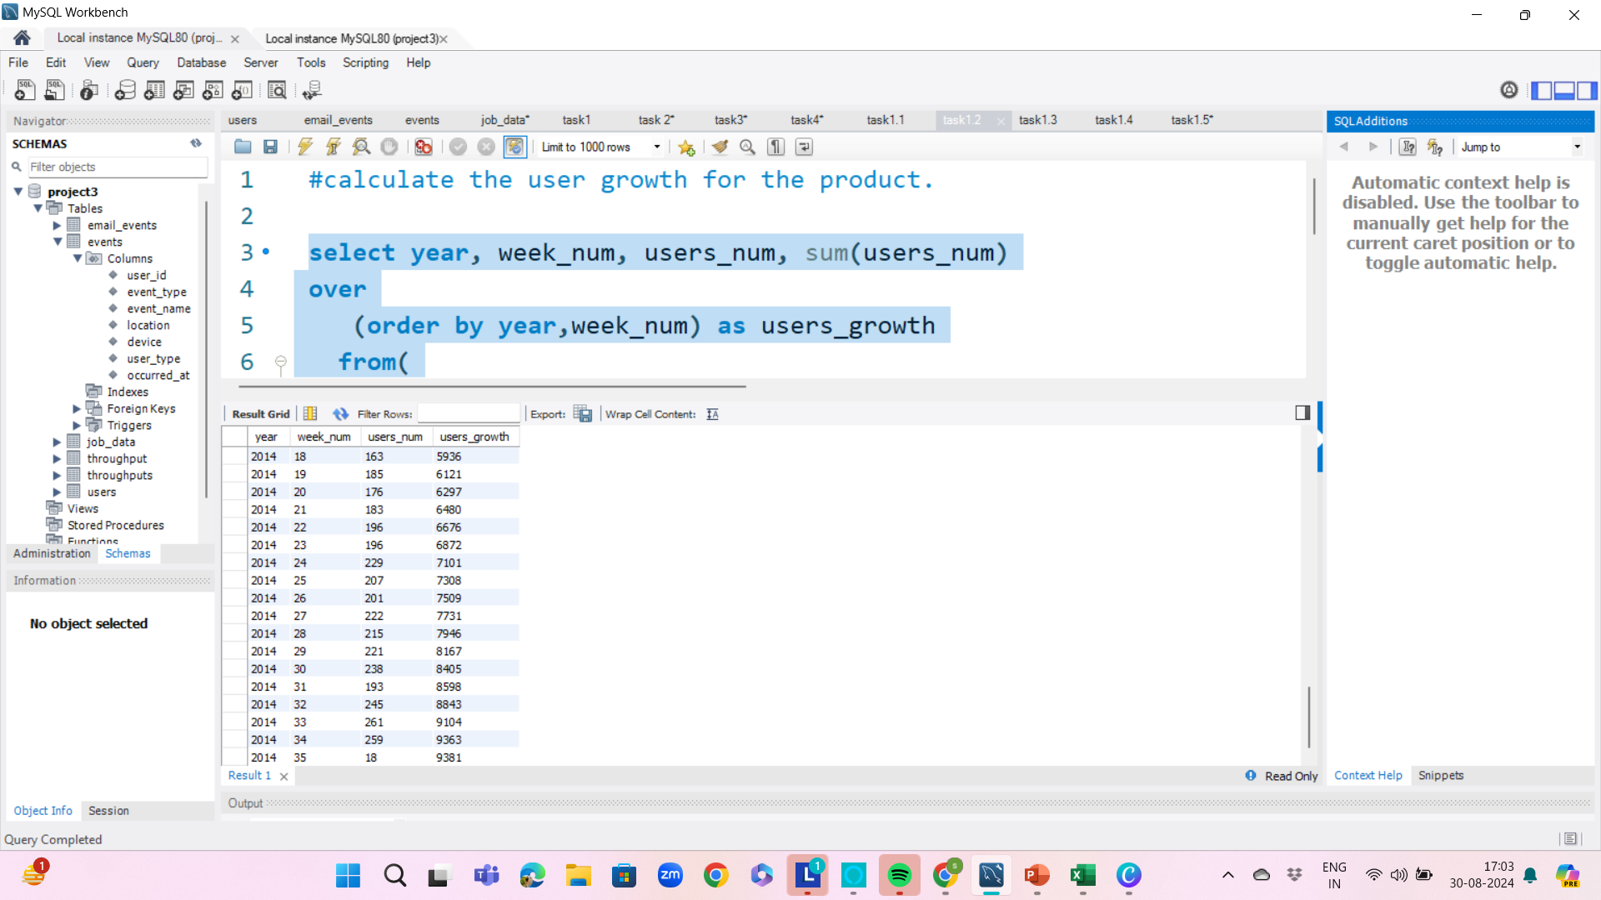
Task b: Write an SQL query to calculate the user growth for the product.

Slide 19


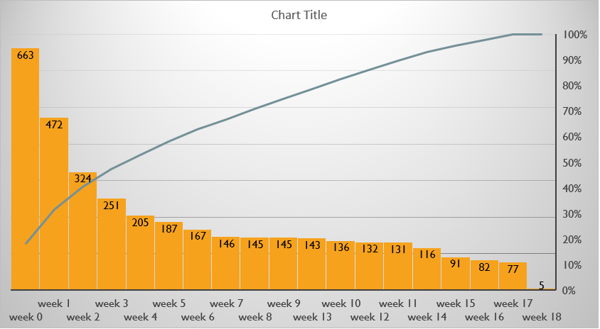
Task c: Weekly Retention Analysis
Objective: Analyze the retention of users on a weekly basis after signing up for a product

Slide 20
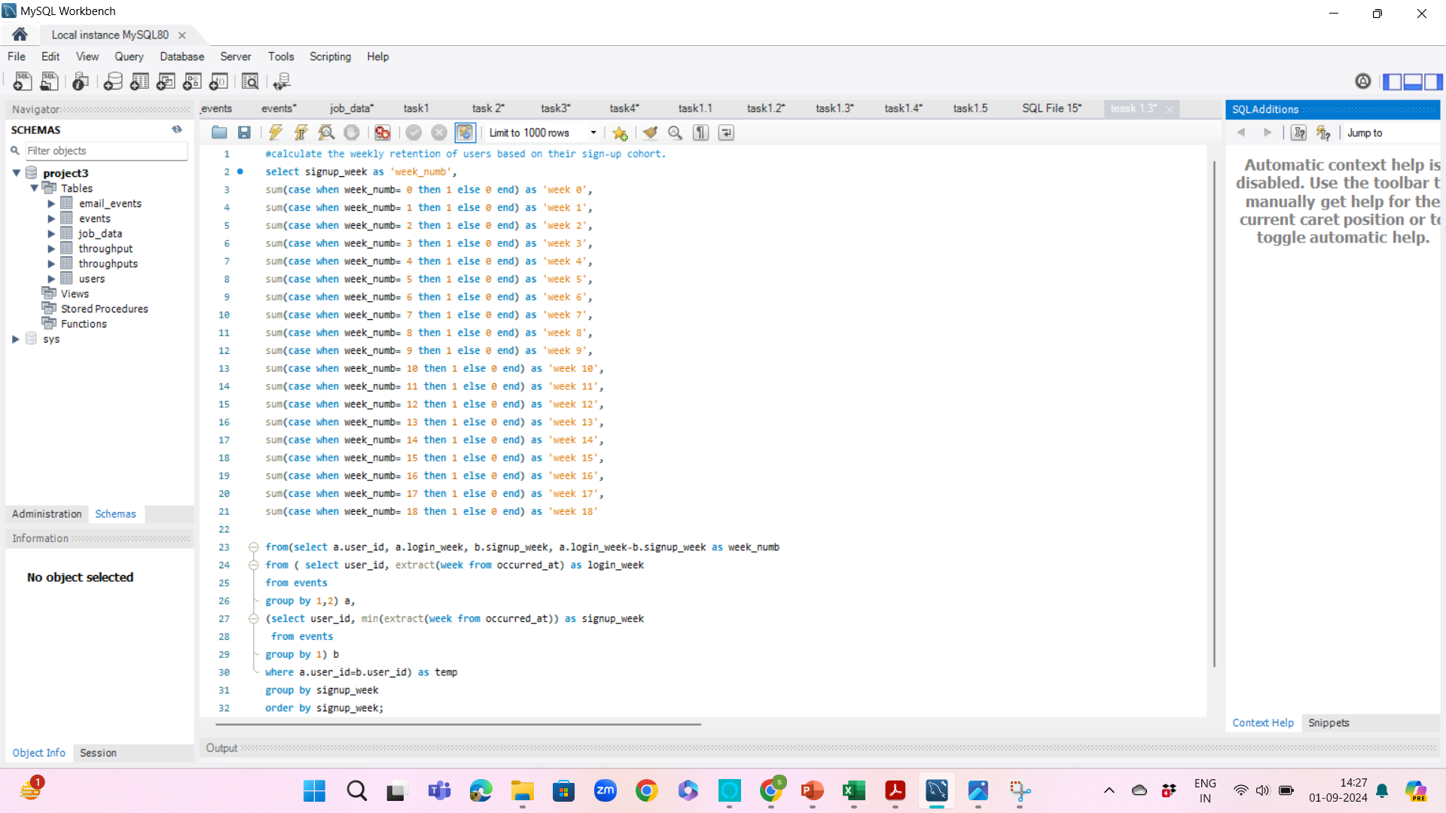
Task c: Write an SQL query to calculate the weekly retention of users based on their sign-up cohort.

Slide 21
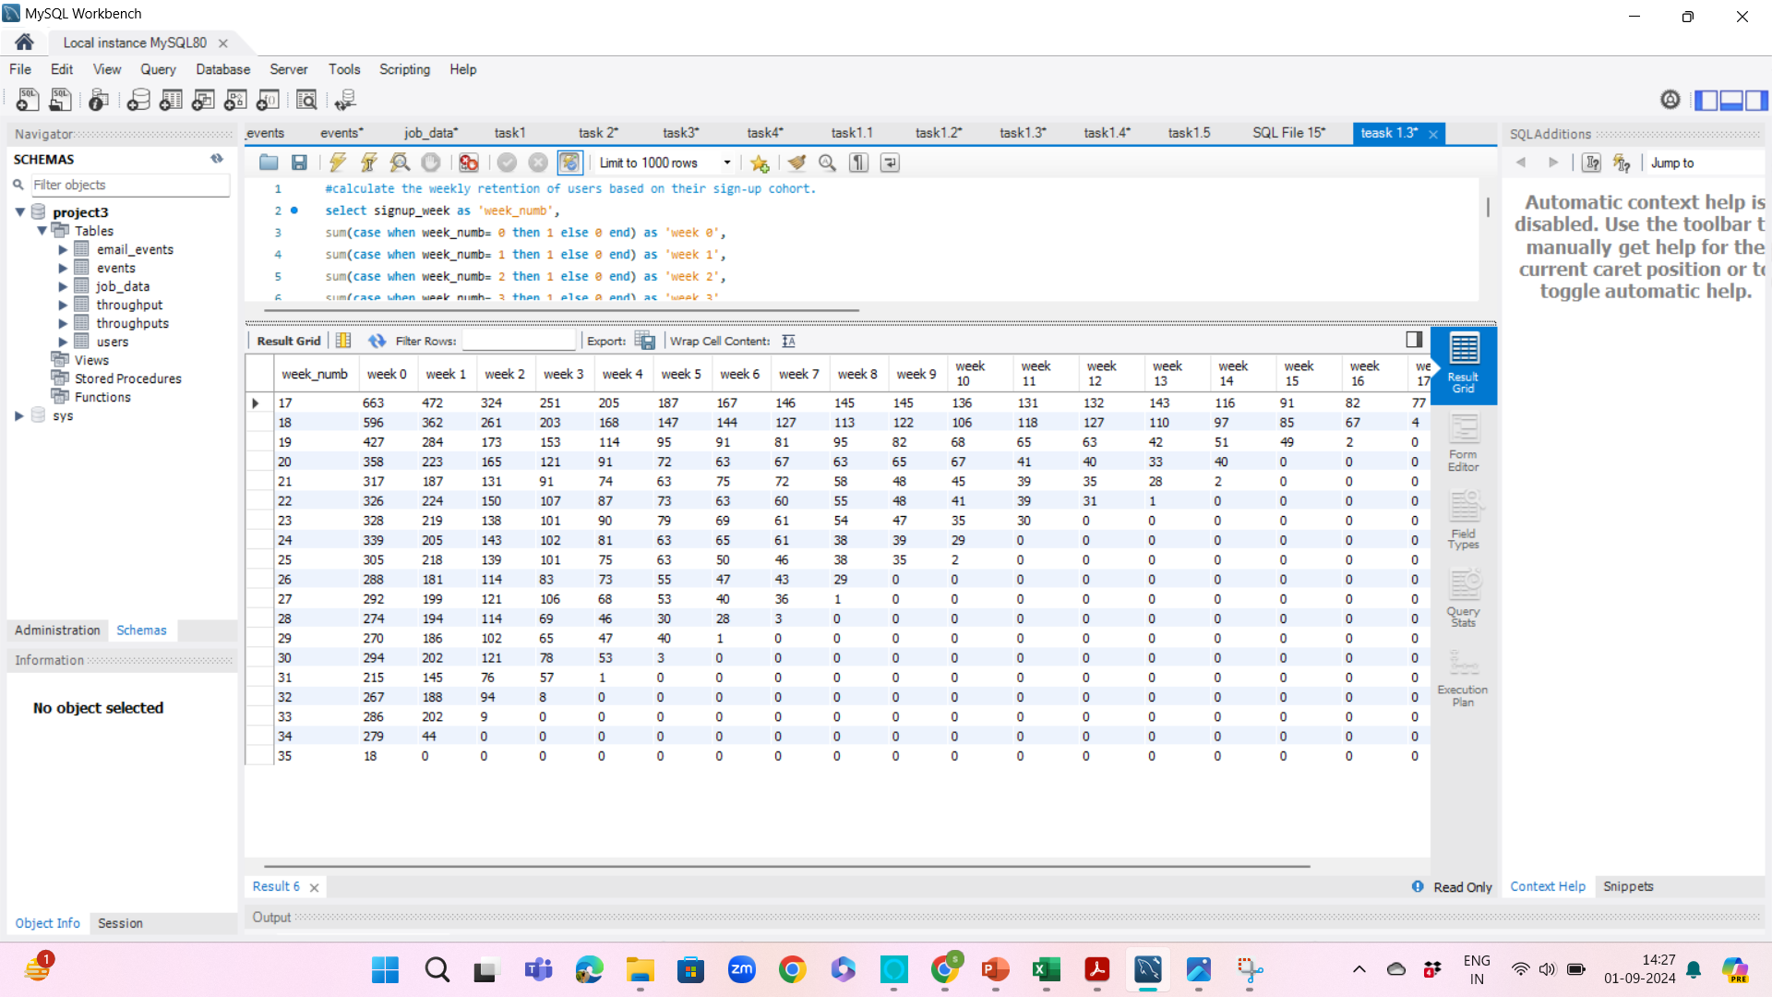
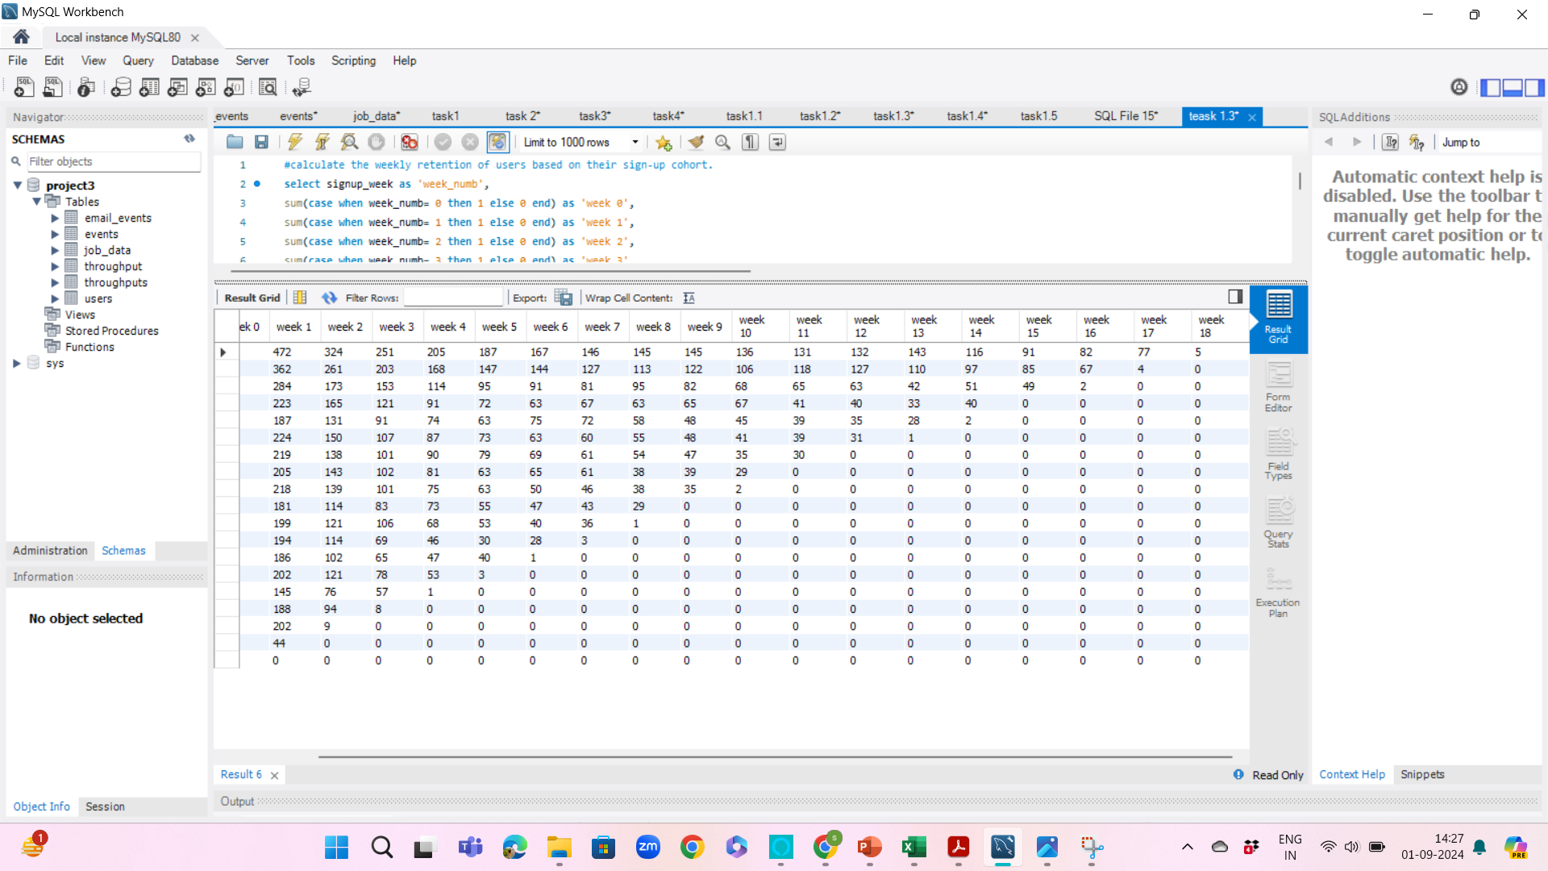
Task c: SQL query output of weekly retention of users based on their sign-up cohort.

Slide 22

Task d: Weekly Engagement Per Device
Objective: Measure the activeness of users on a weekly basis per device
The Highest engagement is on the MacBook pro on week 30
The Lowest engagement is on the Samsung galaxy tablet on week 35

Slide 23
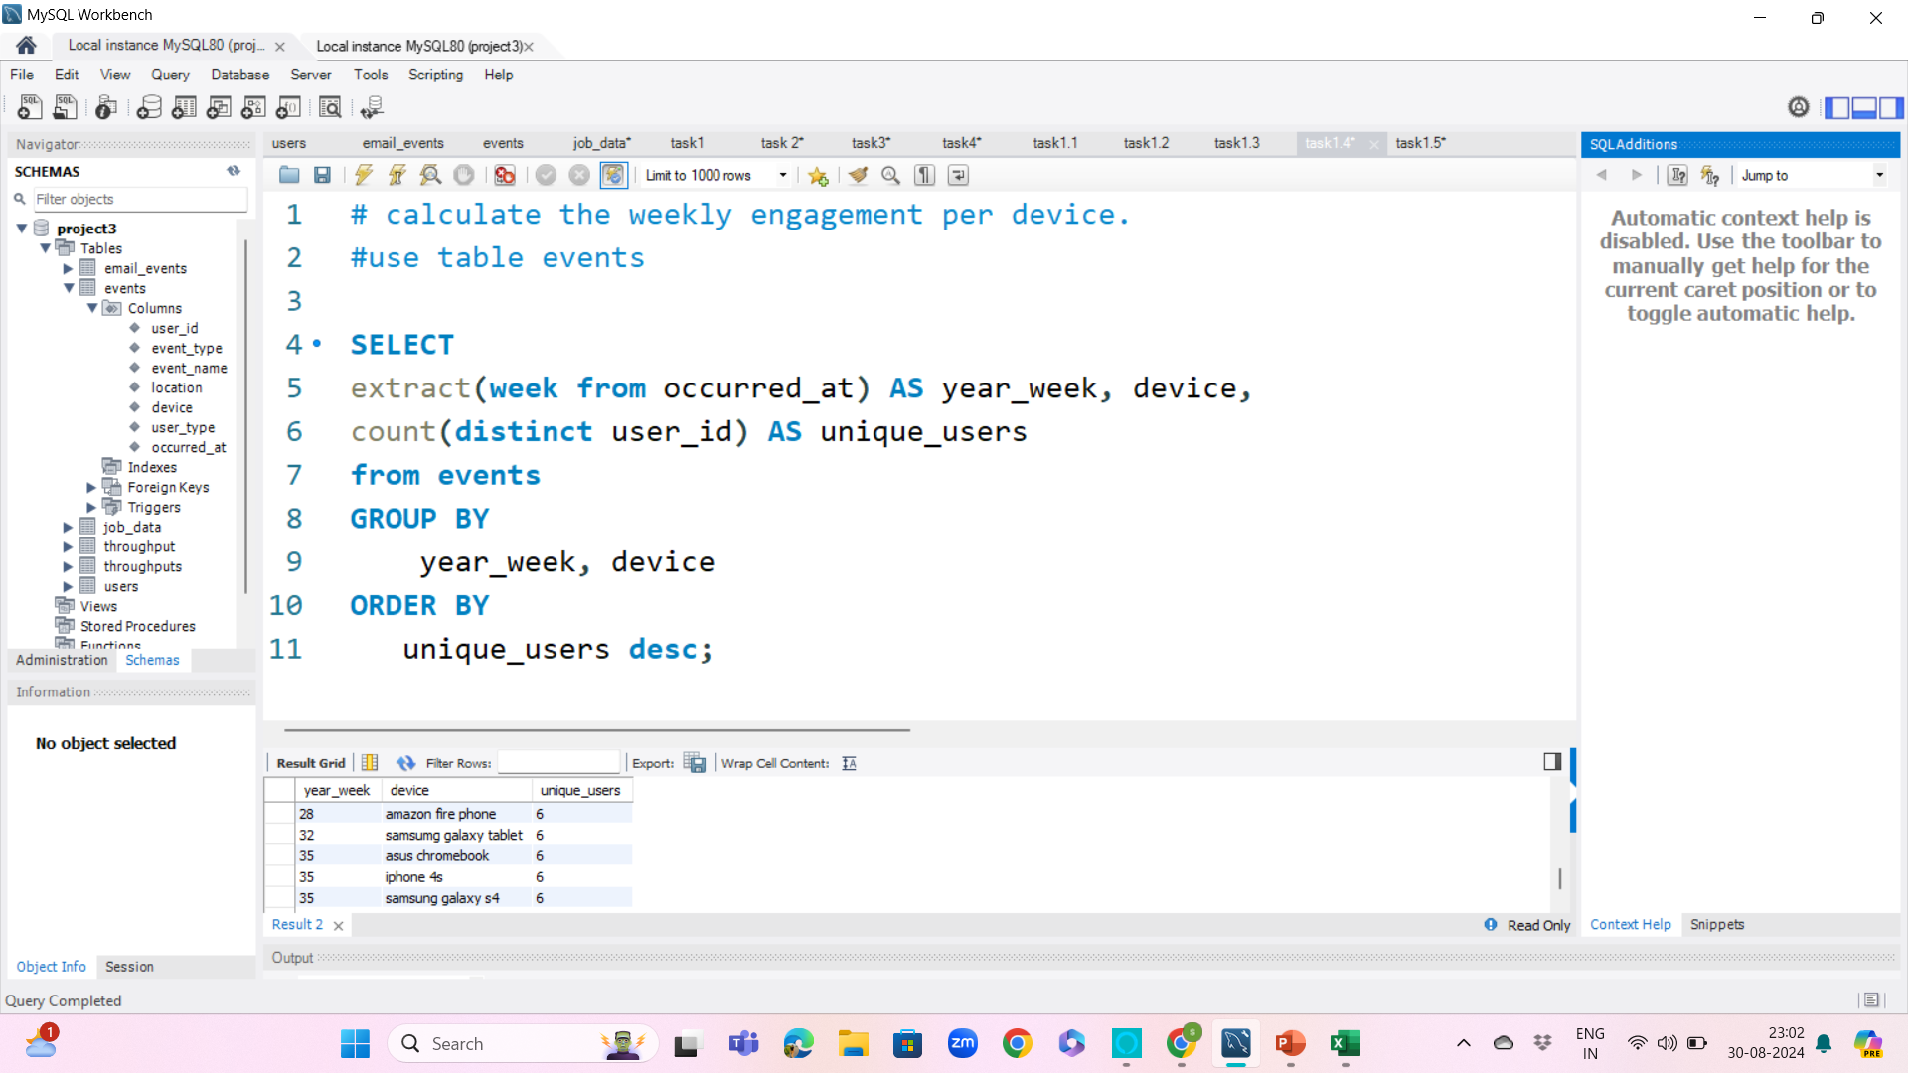
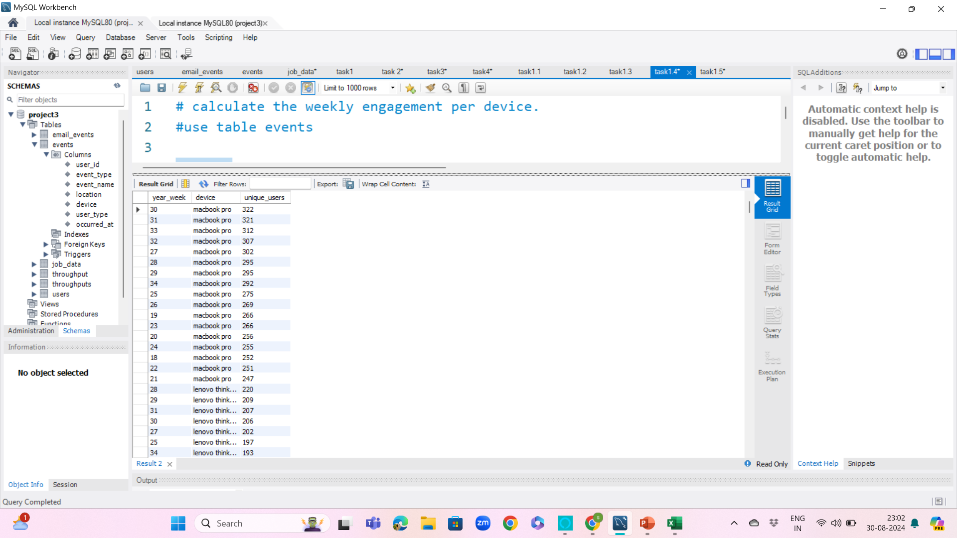
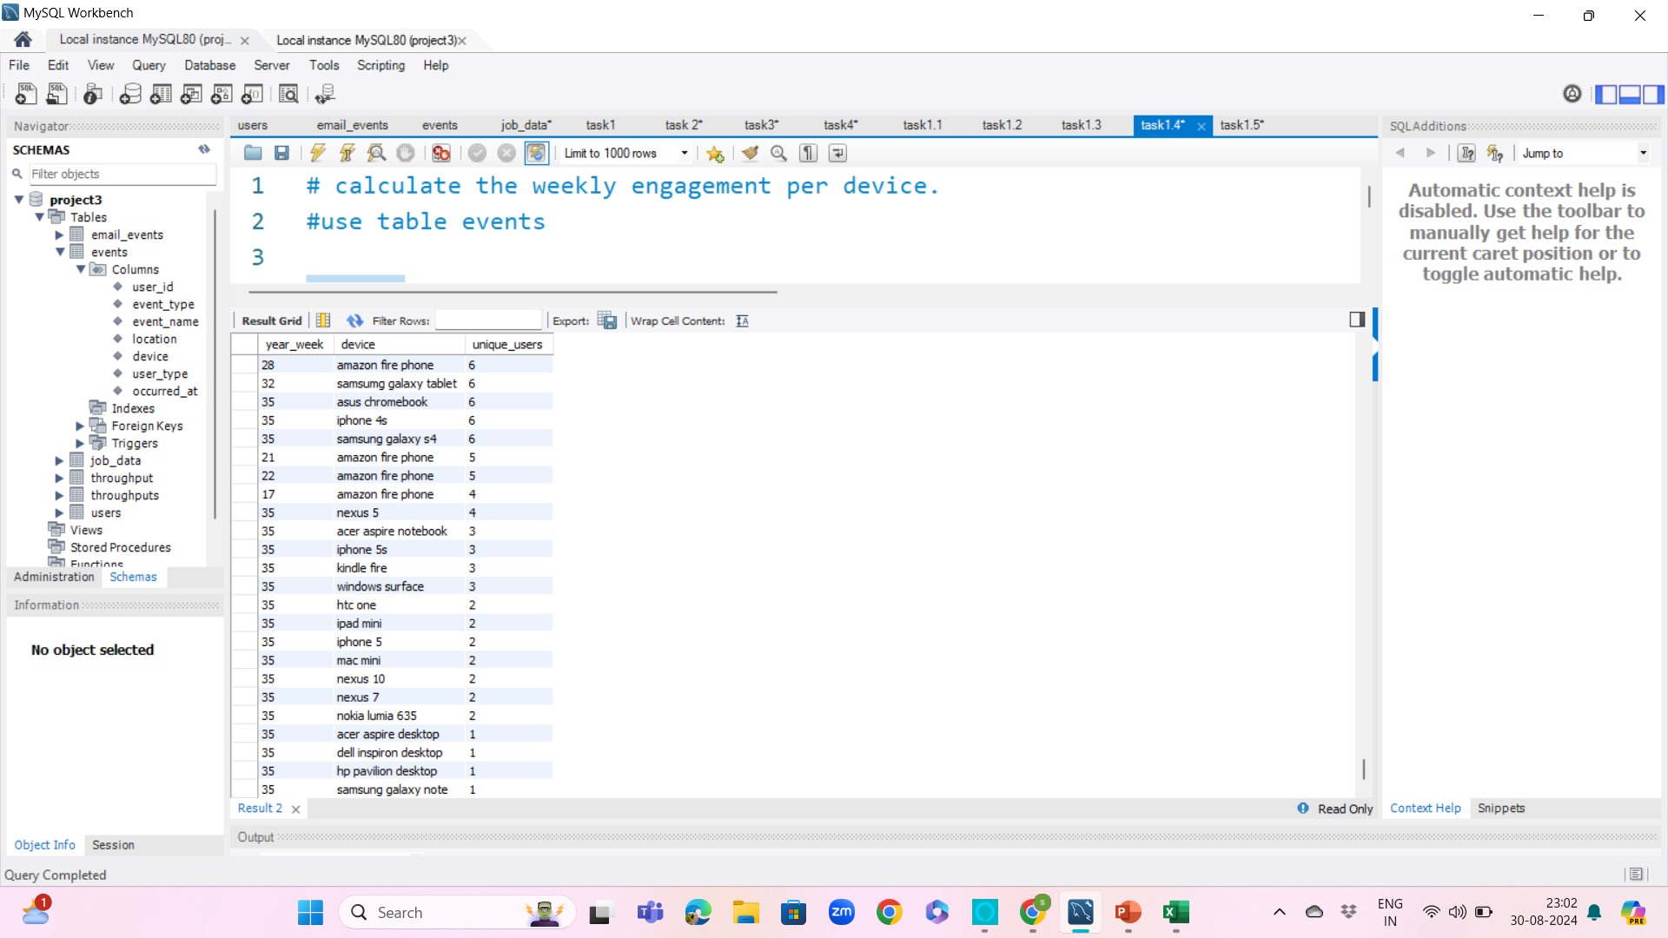
Task d: Write an SQL query to calculate the weekly engagement per device.

Slide 24


Task e: Email Engagement Analysis
Objective: Analyze how users are engaging with the email service
The highest engagement using email services:
Week 34
The lowest email engagement.
Week 34 has

Slide 25
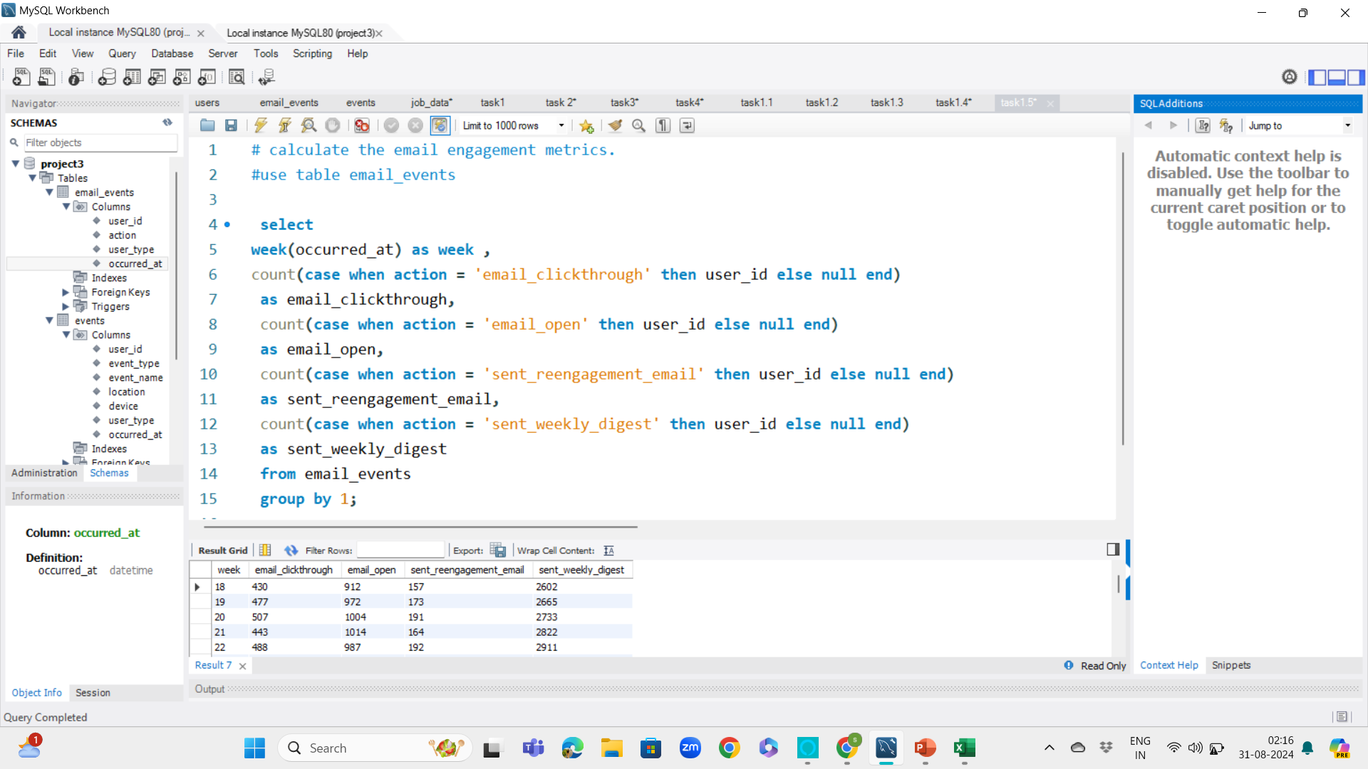
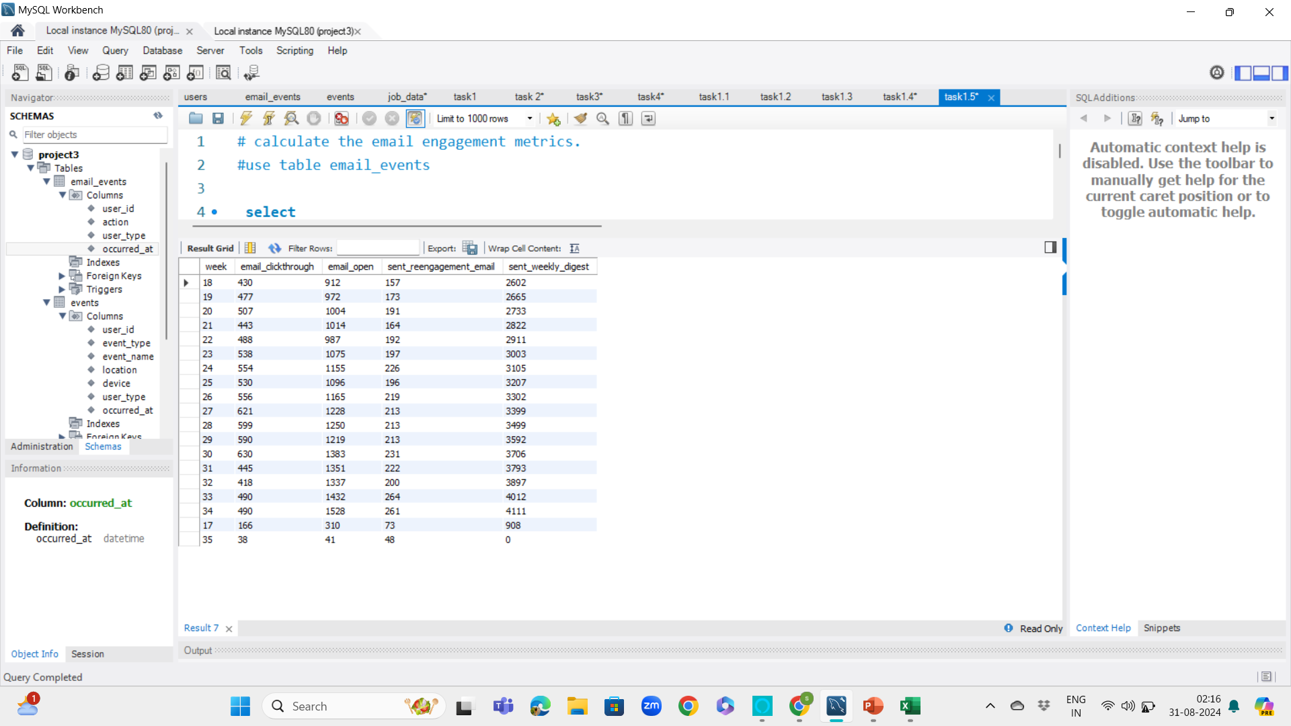
Task E: Write an SQL query to calculate the email engagement metrics.

Slide 26

insights
CASE STUDY 1
Jobs Reviewed Over Time: - 218 Jobs were reviewed on 11/28/2020 which was maximum among other days.
Throughput Analysis: - 7-day rolling average for throughput as it is better to represent the overall performance, also it provides a clearer trend over time than daily metric.
Language Share Analysis: - Highest percentage-French language(34.90),lowest percentage – Hindi(3.69)
Duplicate Rows Detection:- actor_id(1003) has 2 duplicates.
CASE STUDY 2
Weekly User Engagement:- Week 30 has maximum active users while week 17 has min active users
User Growth Analysis:- Week 33 has highest user growth while week 35 has lowest user growth.
Weekly Engagement Per Device :- Week 30 has maximum active users on MacBook Pro while week 35 has minimum active users on acer aspire desktop.
Email Engagement Analysis Week 34 has highest engagement using email services while week 35 has lowest email engagement.

Slide 27

results
This project helped me to advance my query writing techniques and problem solving ability.
The challenges that I faced in this project was about importing large size ‘Event’ CSV file into database which was taking lot of time to import using table data import wizard option so instead I used load data statement to import large dataset into database.

Slide 28


